Slide 1

SHRI G.S. INSTITUTE OF TECHNOLOGY AND SCIENCE INDORE Department of Information Technology Subject Name: Web Engineering Subject Code: IT38504 Topic: Cascading Style Sheets (CSS)
Submitted by: Submitted to:
Bhanu Raghuwanshi Dr. Lalit Purohit
Bhoopendra Singh Mr. Upendra Singh
Divyanshi Ravat

Slide 2
Introduction to CSS
Cascading Style Sheets (CSS) is a style sheet language used for describing the presentation of a document written in HTML or XML, including colors,layouts, and fonts. It allows the separation of content from presentation, enabling the easy customization of the look and feel of a webpage.
CSS Syntax:
The CSS syntax consists of a selector and adeclaration block. The selector is used to target the HTML element, and the declaration block contains one or more property-valuepairs.
CSS Selectors:
CSS selectors are used to target theelements to which the styles are to be applied. They can be based on element name, class, ID, attributes, or even pseudoclasses.

Slide 3
Types of CSS:
1. Inline CSS: Inline CSS is a way of defining the styling of an HTML element by adding CSS rules directly to the element’s tag using the “style” attribute.
2.Internal CSS: Internal CSS, also known as embedded CSS is a method of adding CSS rules directly to the head section of an HTML document.
External CSS: External CSS is used to place CSS code in a separate file and link to the HTML document.

Slide 4
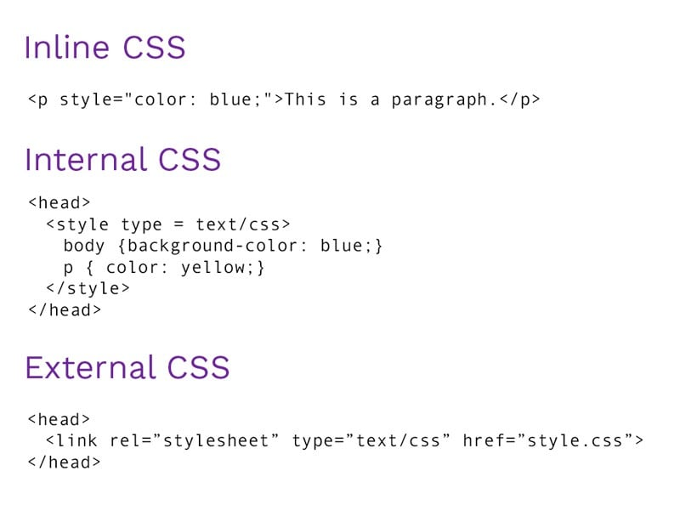

Slide 5



Style sheet contain one or more CSS Rules
Selector
body {
font-family: Tahoma, Arial, sans-serif; color: black;
background: white; margin: 8px;
Declaration Block
}
Value
Property

Slide 6
CSS Selector | CSS | HTML
Tag name | h1 {color: red;} | <h1>Today’s Specials</h1>
Class attribute | .large {font-size: 16pt;} | <p class="large">...
Tag and Class | p.large {...} | <p class="large">...
Element id | #p20 {font-weight: bold;} | <p id="p20">...
Hover (pseudo selector) | p:hover {background-color:blue}; | <p>...

Slide 7
CSS Properties
Control many style properties of an element:
Coloring
Size
Position
Visibility
Many more: (e.g. p: { text-decoration: line-through; })
Also used in animation

Slide 8
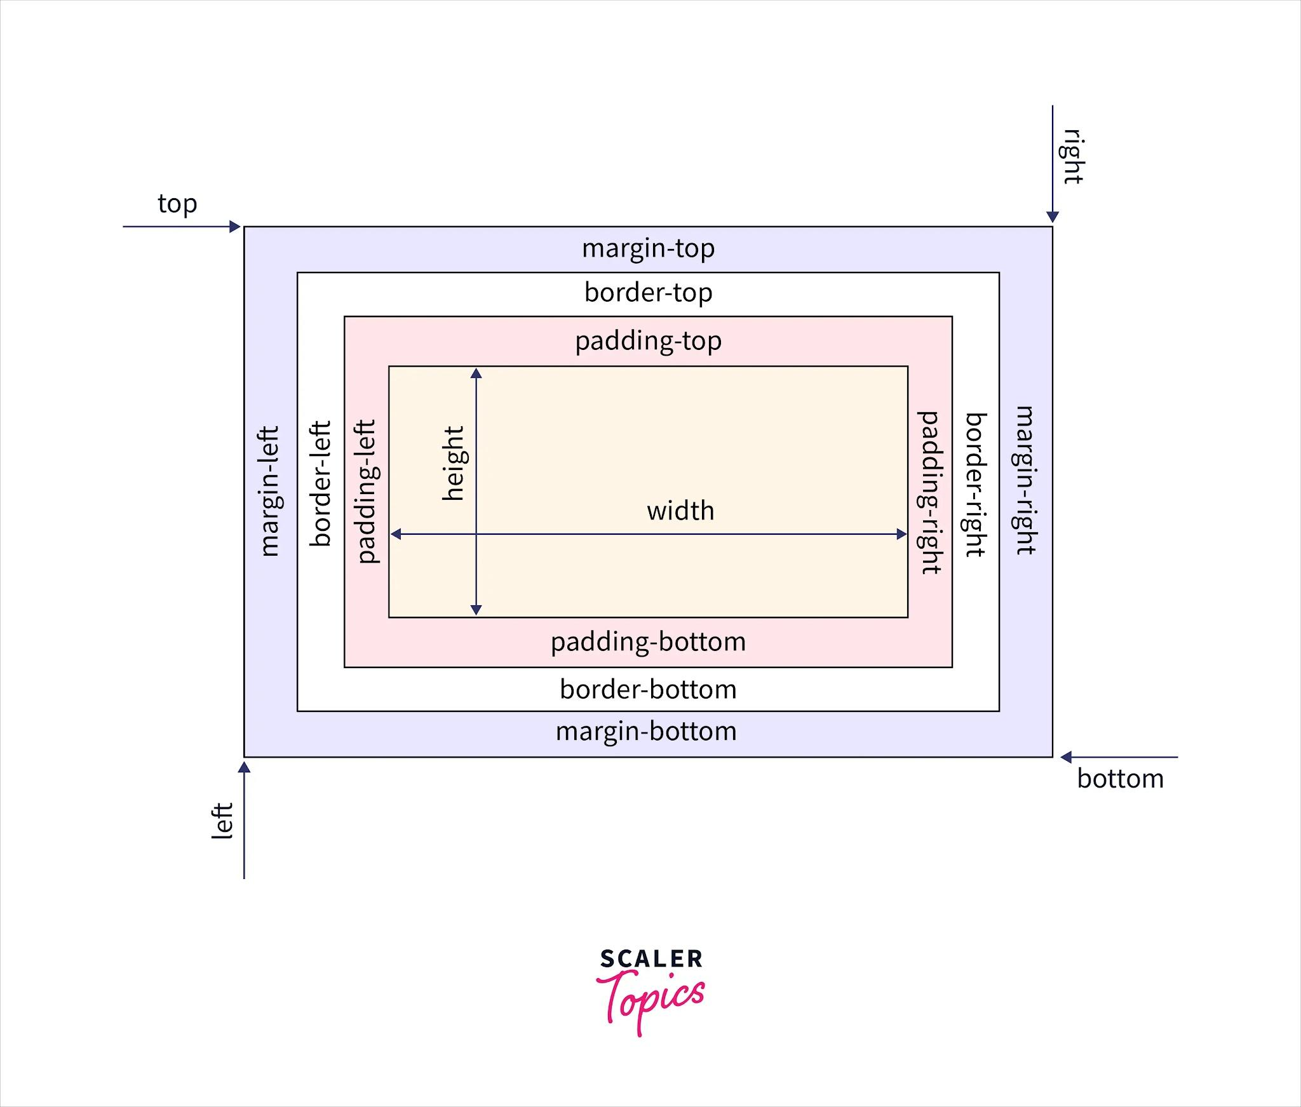
CSS Box Model

Slide 9
Properties regarding box-model in CSS:
1. Content:
The content area where text, images, and other elements are placed.
2. Padding:
The transparent area around the content, inside the border.
3. Border:
The border around the padding and content.
4. Margin:
The area outside the border, separating the element from other
elements.

Slide 10
Some more common properties
Background properties:
background-image: image for element's background
background-repeat: should background image be displayed in a repeating pattern (versus once only)
Font properties:
font, font-family, font-size, font-weight, font-style:
Position Property:
The position property specifies the type of positioning method used for an element.
position:static,relative,absolute,fixed

Slide 11
Element visibility control properties
display: none; - Element is not displayed and takes no space in layout.
display: inline; - Element is treated as an inline element (takes only required space).
display: block; - Element is treated as a block element (takes the whole width available).
display: flex; - Element is treated as a flex container.
display: grid; - Element is treated as a grid container.
visibility: hidden; - Element is hidden but space still allocated.
visibility: visible; - Element is normally displayed

Slide 12
Flexbox
display: flex; (Flexbox)
Flexbox, or the Flexible Box Layout, is a layout model in CSS that allows you to design complex layouts more efficiently and with less code than traditional models. It provides an efficient way to distribute space and align items within a container, even when their size is unknown or dynamic.
Flexbox is particularly useful for creating responsive designs and handling various screen sizes.
Flexbox layout the elements in one dimension (row or column)
unlike Grid as that layout elements in two dimensions

Slide 13
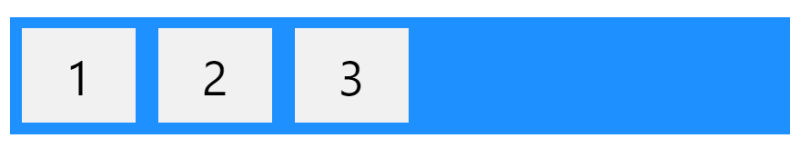
Flexbox Elemnts:
To start using the Flexbox model, we need to first define a flex container.
<div class="flex-container">
<div>1</div>
<div>2</div>
<div>3</div>
</div>
The element above represents a flex container (the blue area) with three flex items.

Slide 14

Parent Element (Container)
The flex container(the blue area) becomes flexible by setting the display property to flex:
.flex-container {
display: flex;
}

Slide 15
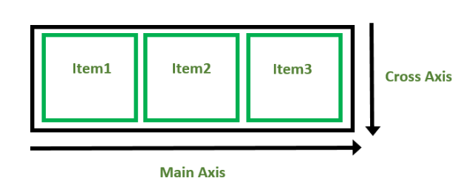
Flexbox Axes
While wox, we deal with 2 axes:
Main Axis
By default, the main axis runs from left to right. (horizontal axis)
Cross Axis
By default, Cross Axis runs perpendicular to the Main Axis i.e. from top to bottom. (vertical axis)

Slide 16
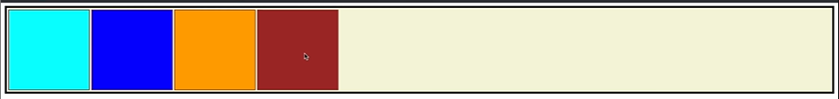
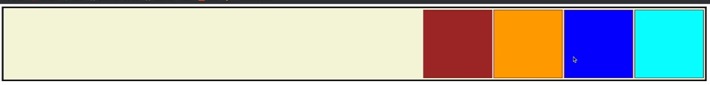
Flexbox Properties:
The flex container properties are:
1. Flex Direction:
This establishes the main-axis, thus defining the direction flex items are placed in the flex container.
row (default): left to right in ltr; right to left in rtl
flex-direction: row
row-reverse: right to left in ltr; left to right in rtl
flex-direction: row-reverse;

Slide 17
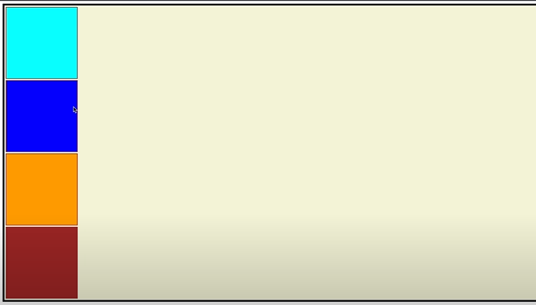
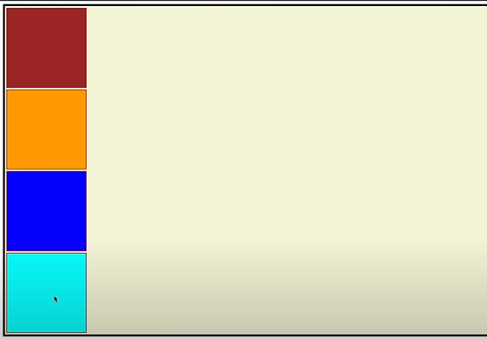
column: same as row but top to bottom
flex-direction: column;
column-reverse: same as row-reverse but bottom to top
flex-direction: column-reverse;

Slide 18
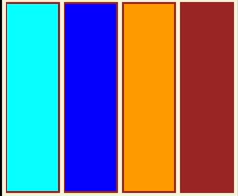
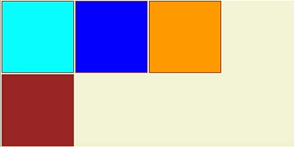
2.Flex Wrap:
The CSS flex-wrap property is used to specify whether flex items are forced into a single line or wrapped onto multiple lines
Default Value: nowrap
Because of this by reducing the browser width the items do not get squeezed
1.flex-wrap: nowrap;
Default value. Specifies that the flexible items will not wrap
2.flex-wrap: wrap;
Specifies that the flexible items will wrap if necessary

Slide 19
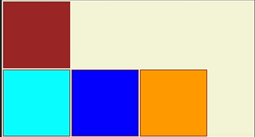
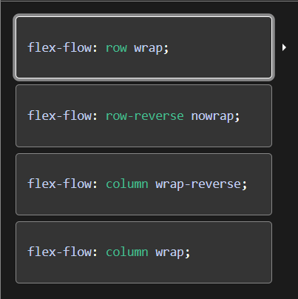
3.flex-wrap: wrap-reverse;
Specifies that the flexible items will wrap, if necessary, in reverse order
The flex-flow CSS shorthand property specifies the direction of a flex container, as well as its wrapping behavior.

Slide 20
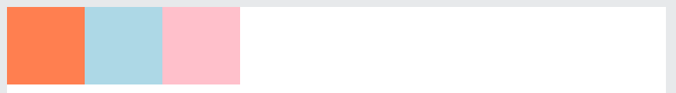
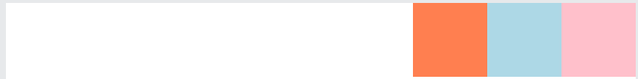
3.Justify Content
The justify-content property in CSS is used to describe the alignment of the flexible box container. It contains the space between and around content items along the main axis of a flex container which is distributed in a browser.
This property cannot be used to describe items or containers along the vertical axis. Only used for horizontal axis
Default value: flex-start
1.justify-content: flex-start
Default value. Items are positioned at the beginning of the container
2.justify-content: flex-end
Items are positioned at the end of the container

Slide 21

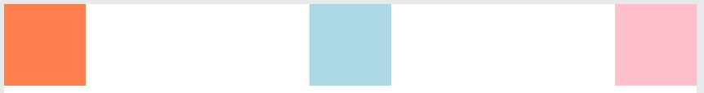
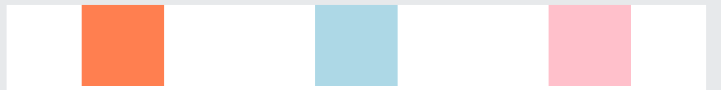

3.justify-content: center;
Items are positioned in the center of the container
4.justify-content: space-between;
Items will have space between them
5.justify-content:space-around;
Items will have space before, between, and after them
6.justify-content: space-evenly;
Items will have equal space around them
7.justify-content: initial;
Sets this property to its default value
8.justify-content: inherit;
Inherits this property from its parent element.

Slide 22
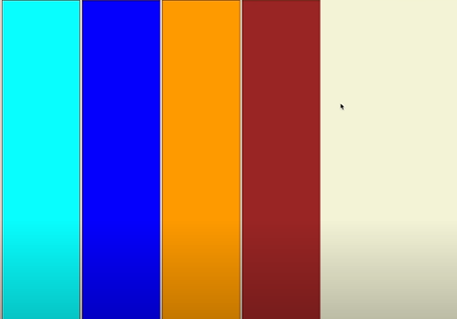
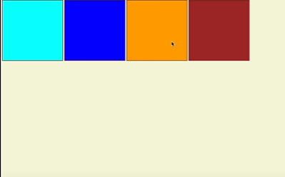
4.Align Items
The align-items property is used to set the alignment of items inside the flexible container or in the given window. It aligns the Flex Items int the cross axis
1.align-items: normal
Default. Behaves like 'stretch' for flexbox
2.align-items: start;
Items are positioned at the beginning of the container

Slide 23
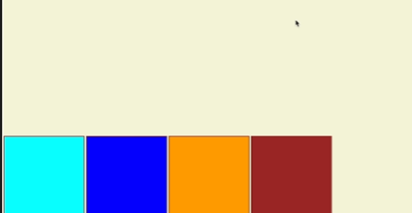
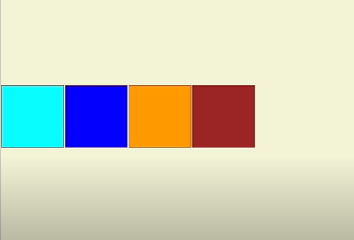
3.align-items: end;
Items are positioned at the end of the container
4.align-items: center;
Items are positioned at the center of the container
5.align-items:initial;
Sets this property to its default value
6.align-items: inherit;
Inherits this property from its parent element.

Slide 24
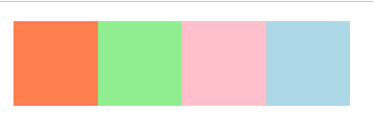
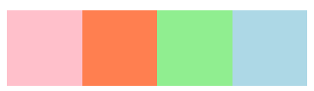
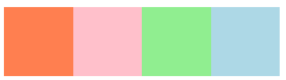

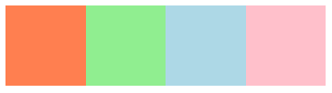
5.Order Property
The order property specifies the order of a flexible item relative to the rest of the flexible items inside the same container.
Note: If the element is not a flexible item, the order property has no effect.
let’s Change the order of the PINK element:
order: 1; order: 2;
order: 3; order: 4;

Slide 25

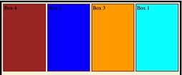

6.Shrink Property
The flex-shrink property specifies how the item will shrink relative to the rest of the flexible items inside the same container.
Note: If the element is not a flexible item, the flex-shrink property has no effect.
let flex-shrink: 4; for box1
here we can see that box1 is shrinking at 4x speed

Slide 26
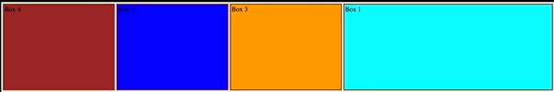

7.Grow Property
The flex-grow property specifies how much the item will grow relative to the rest of the flexible items inside the same container.
Note: If the element is not a flexible item, the flex-grow property has no effect.
let flex-grow: 5; for box 1 and flex-grow: 1; for other boxes

Slide 27
Disadvantages of Flexbox
Browser Compatibility:
Although Flexbox is well-supported in modern browsers, older browsers may not fully support all its features. If you need to support legacy browsers, you might need to provide fallbacks or alternative layout solutions.
Complexity for Some Layouts:
Flexbox is excellent for one-dimensional layouts, such as rows or columns. However, for more complex layouts, such as two-dimensional grids, you might need to combine Flexbox with other layout techniques like CSS Grid, which can introduce additional complexity.
Default Alignment Behavior:
The default alignment of flex items may not always be what you need, and adjusting it might require extra CSS properties. This could lead to more explicit styling for each flex item.
Global Flex Properties:
Flex properties applied to a flex container apply globally to all its children. This lack of isolation might make it challenging to have different flex behaviors for different sections within the same container.

Slide 28
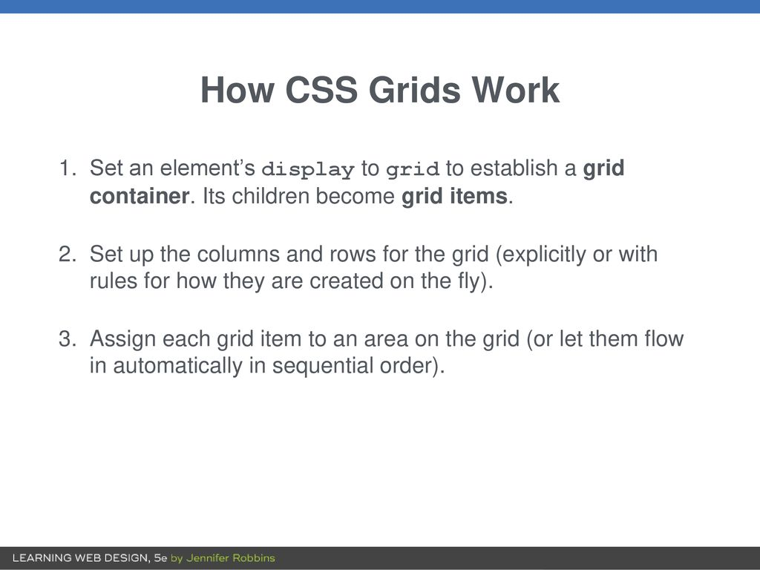

Slide 29
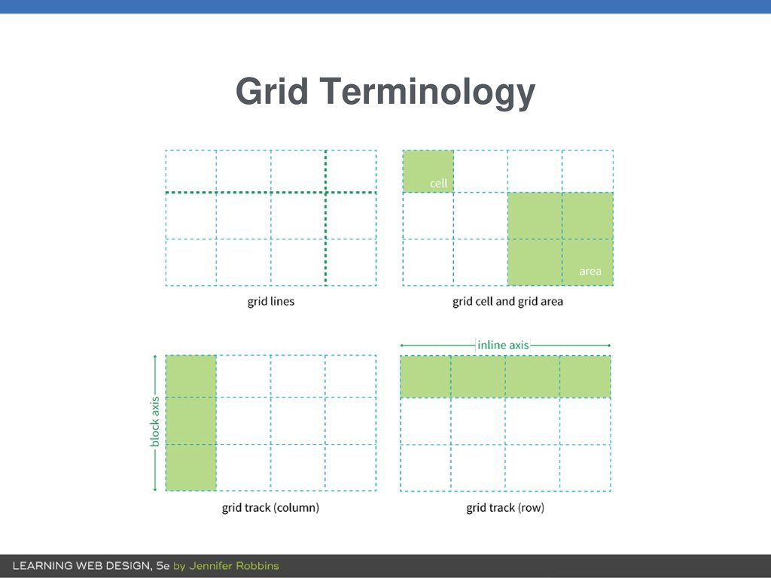

Slide 30
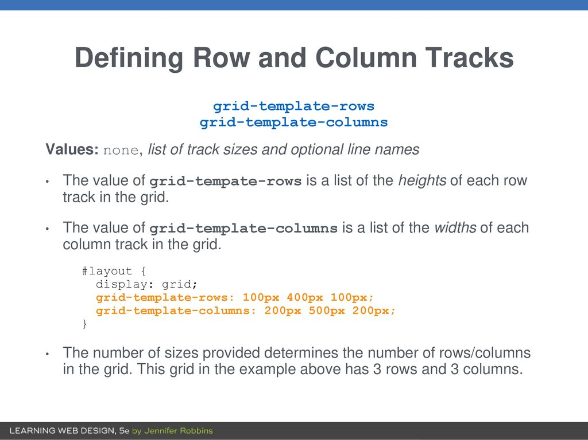

Slide 31
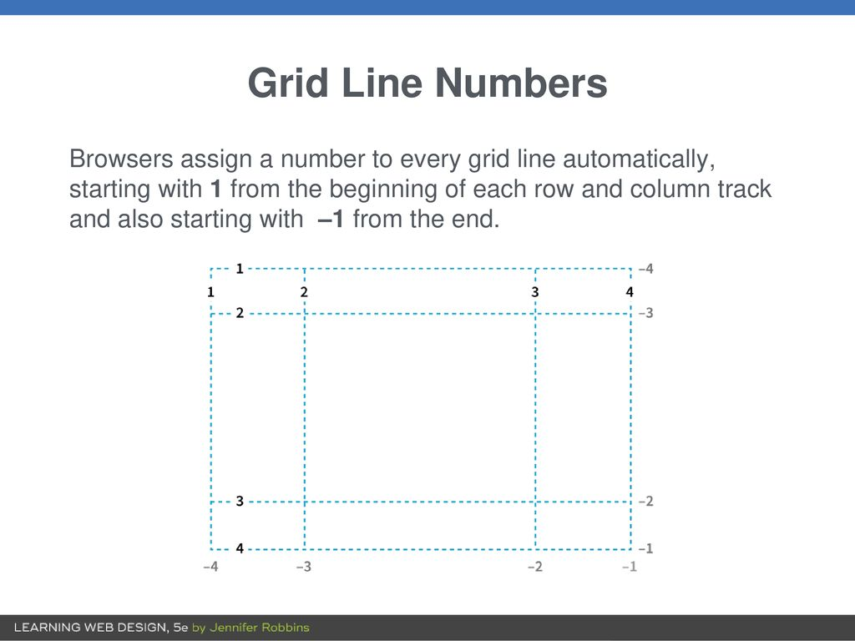

Slide 32
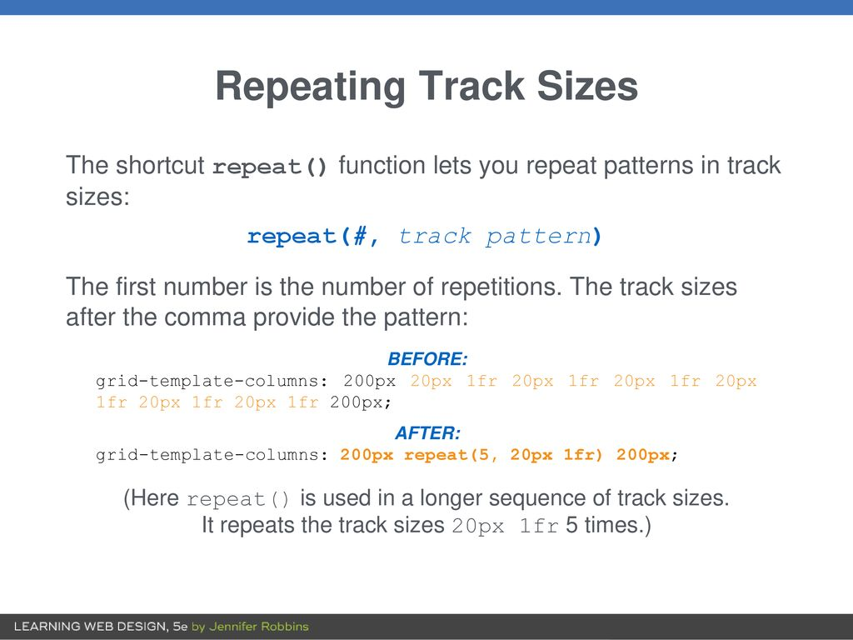

Slide 33
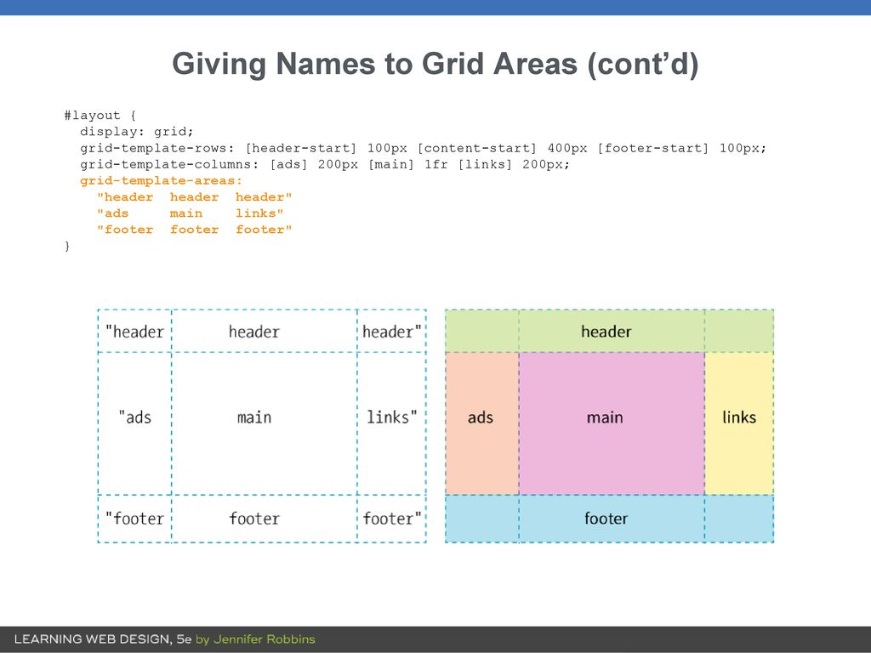

Slide 34
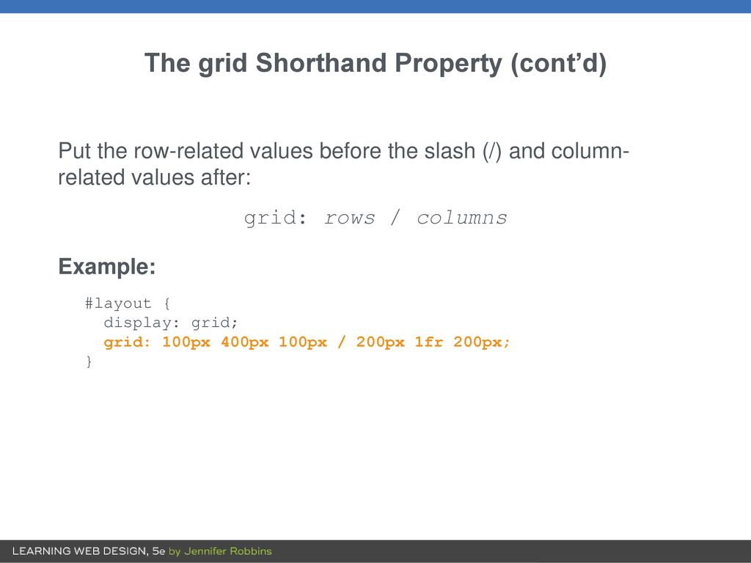

Slide 35
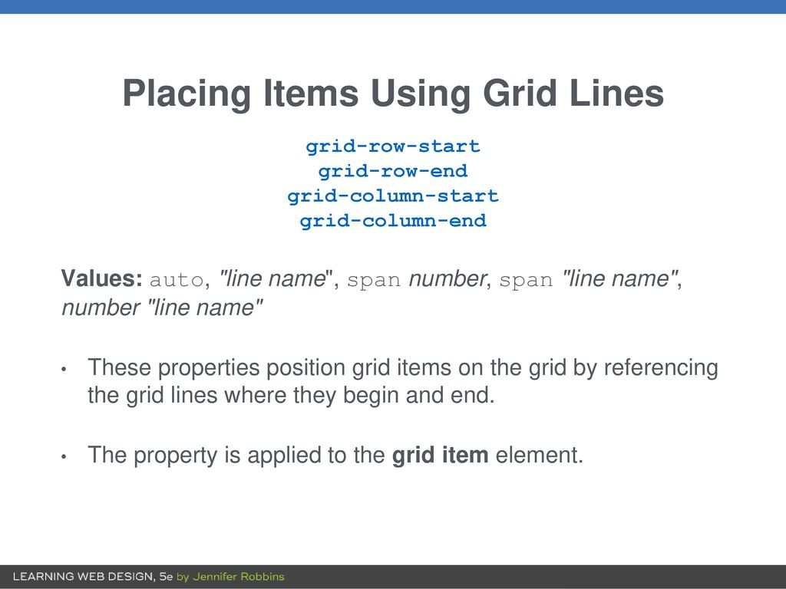

Slide 36
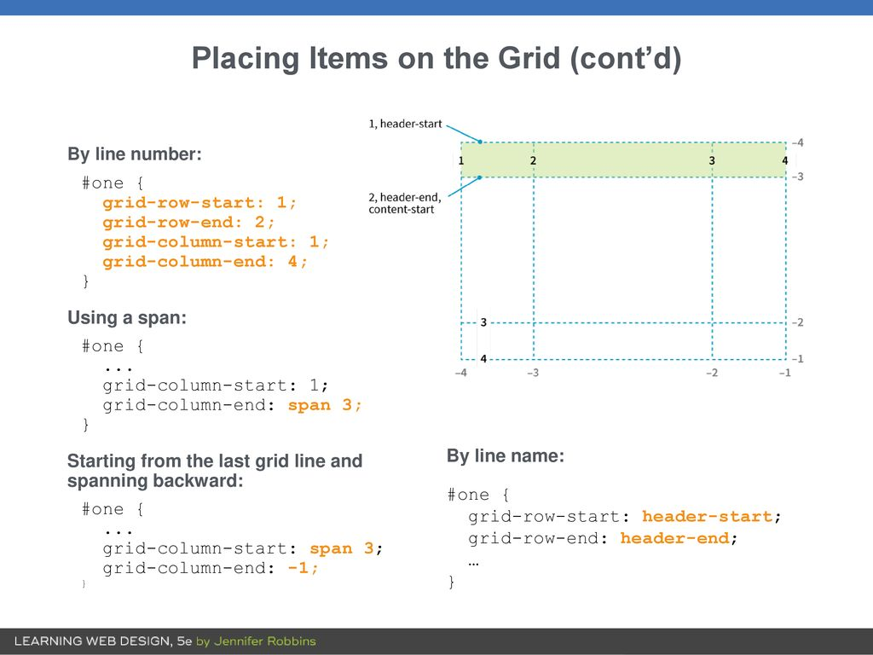

Slide 37
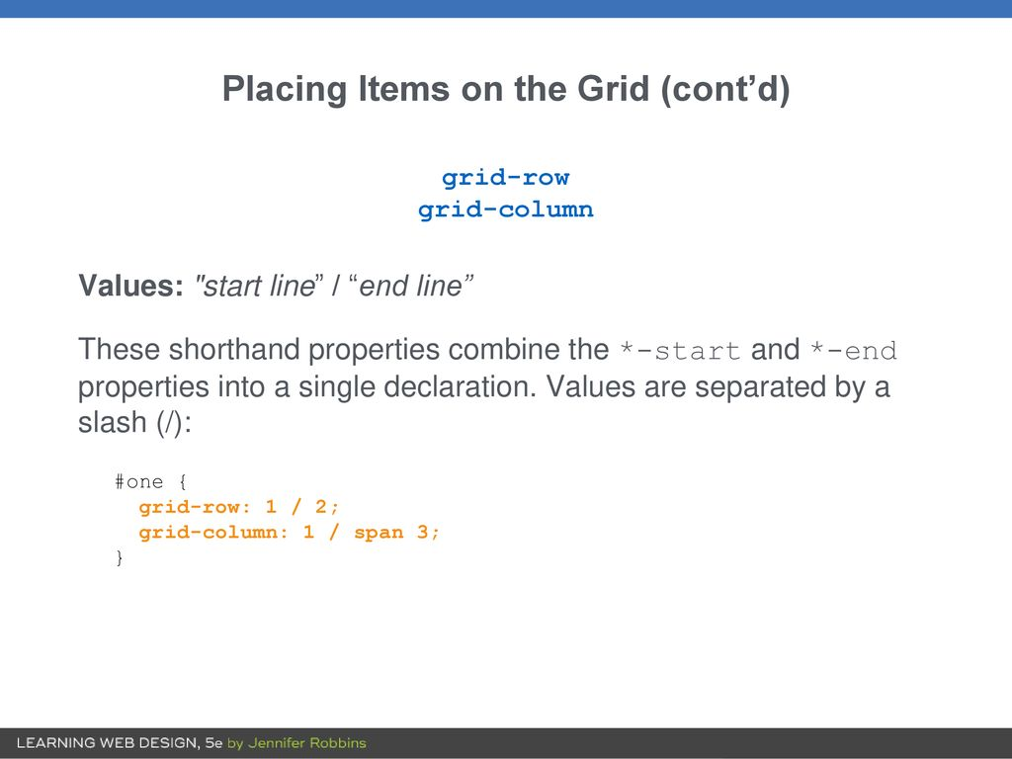

Slide 38
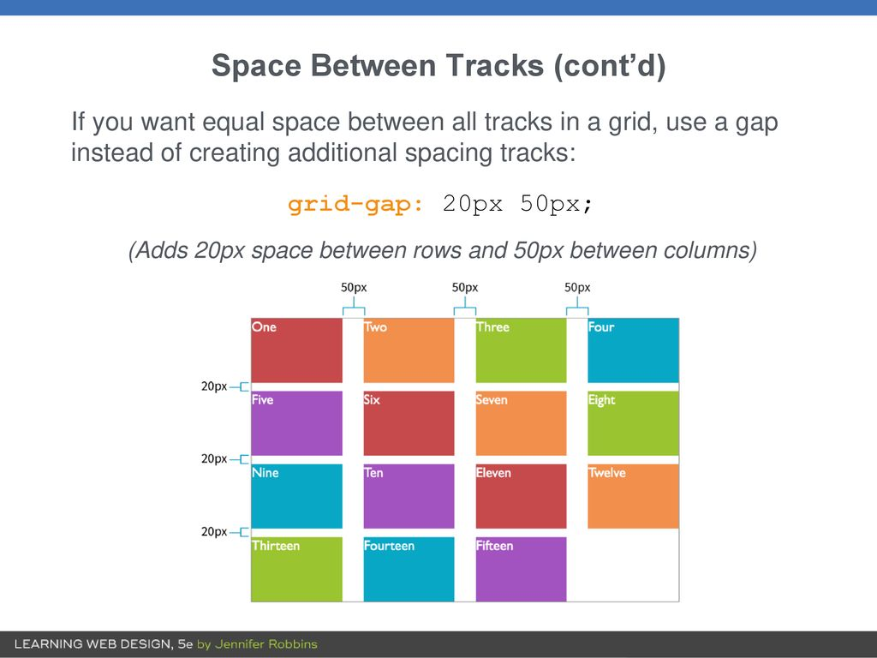

Slide 39
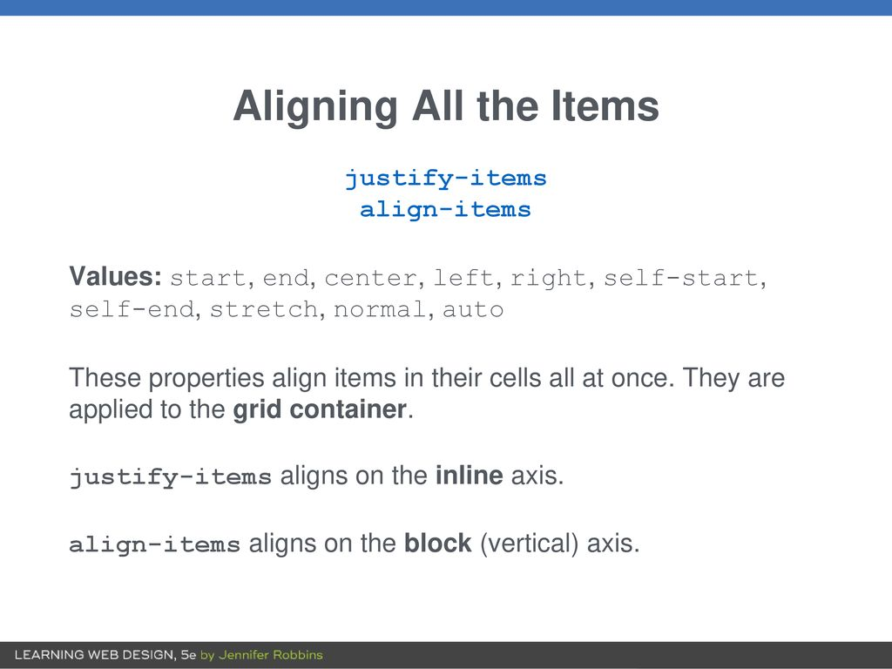

Slide 40
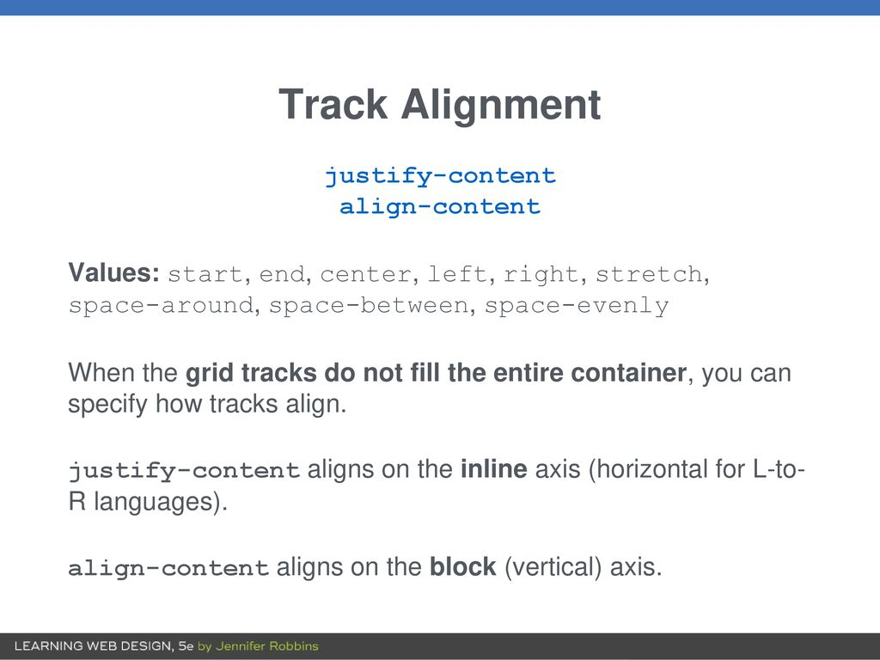

Slide 41
CSS Animation
An animation lets an element gradually change from one style to another.
When you specify CSS styles inside the @keyframes rule, the animation will gradually change from the current style to the new style at certain times.
Example:
div{
background-color:red;
animation name:ex;
animation time:4s}
@keyframes ex{
from{background-color:red}
to{background-color:yellow}}

